Slide 1
Weed cutter machine
Business and Market

Slide 2
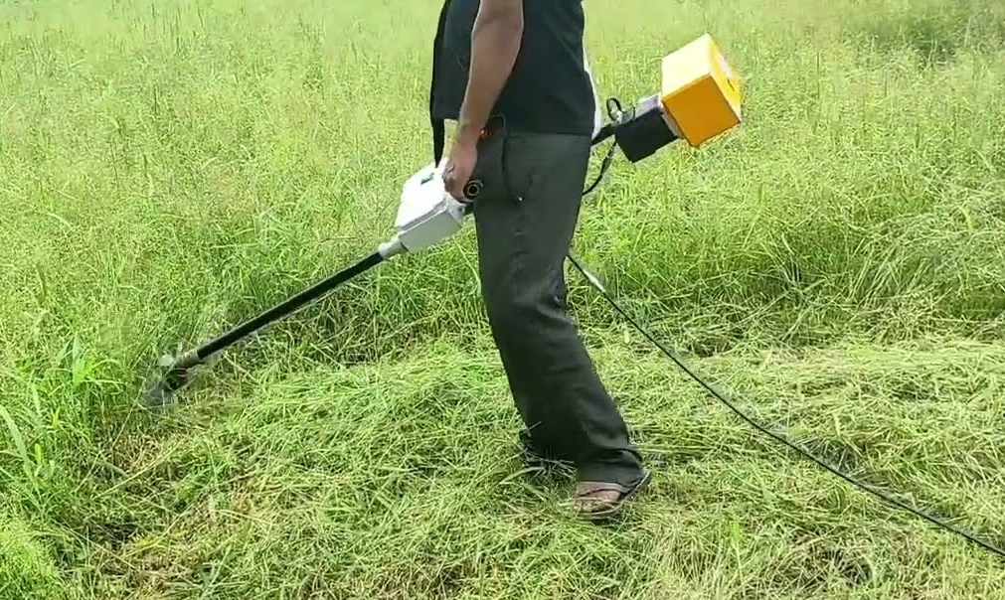
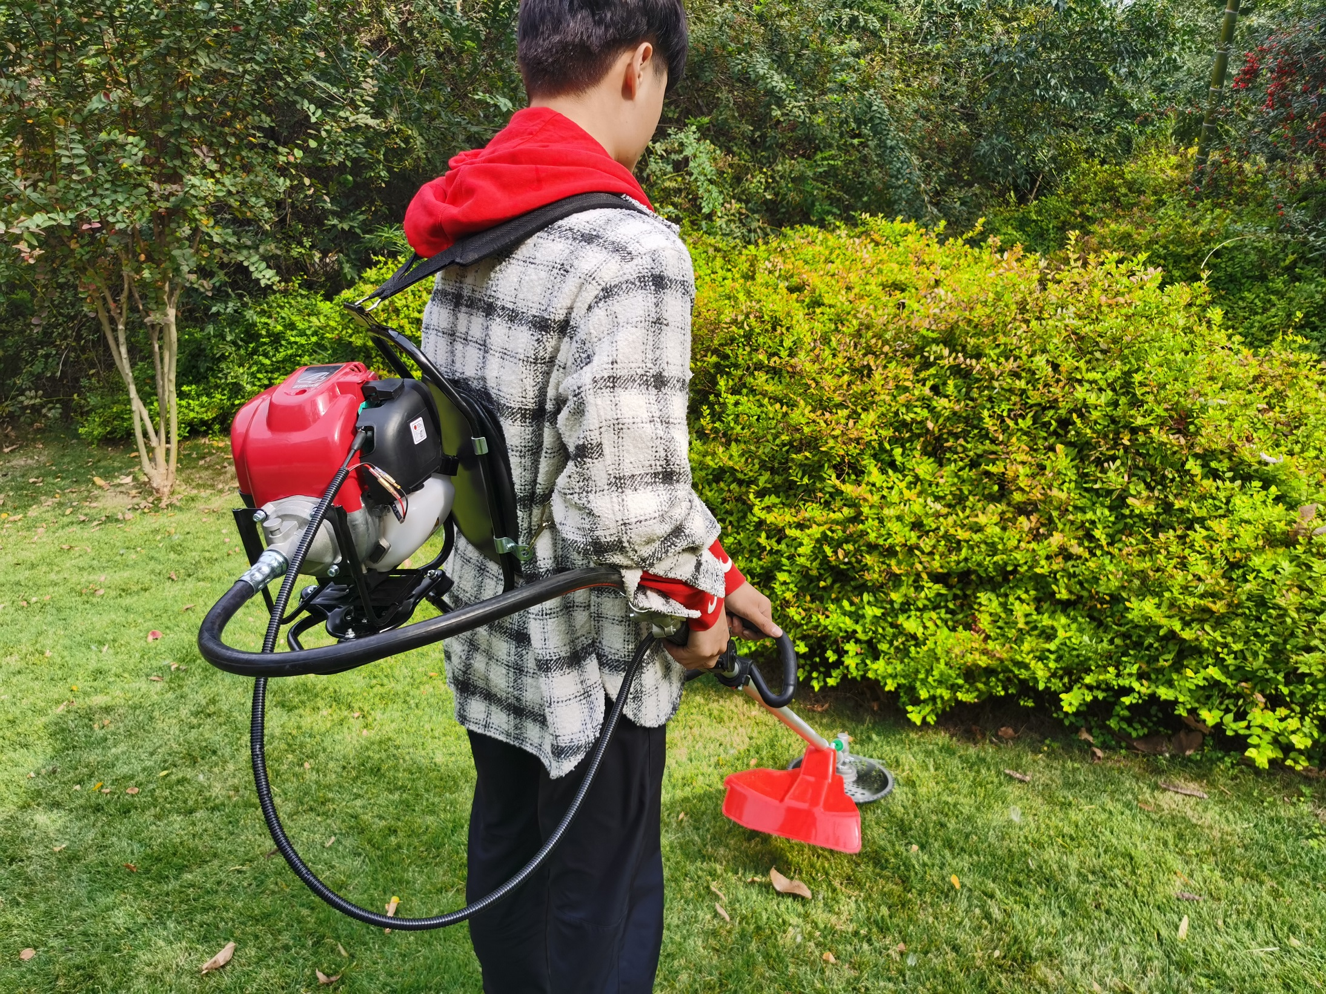
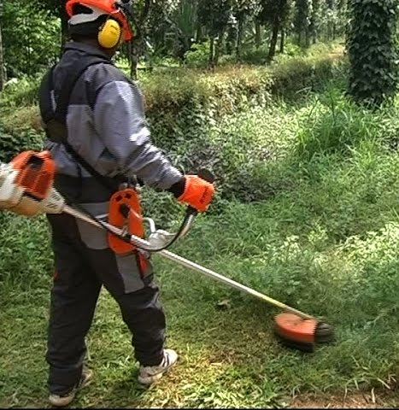
Types of machines
Generally there are 3 types of weed or grass cutters
Gasoline Brush Cutter
Electric Brush cutter
Backpack Brush Cutter

Slide 3
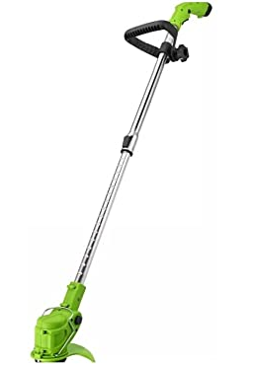
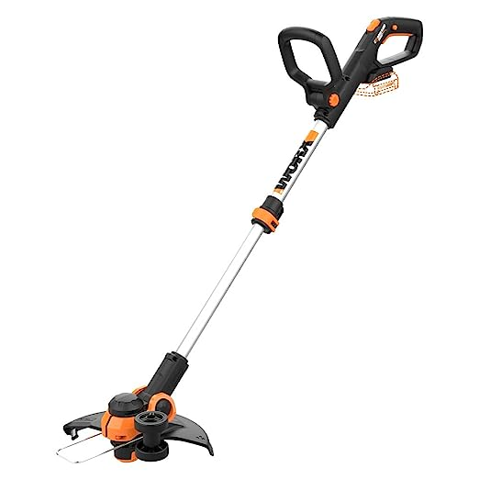
Battery Operated Machines
There are battery operated cutter machines but still they need physical human effort to cut or remove grass or weeds. The prices vary from 4.5k to 25k depends upon motor, battery and facilities.

